Slide 1

Database Systems: Design, Implementation, and Management
Chapter 2
Data Models
Last Revision: 14.10.2022
Notes:
‹#›
‹#›

Slide 2
Objectives
In this chapter, you will learn:
About data modeling and why data models are important
About the basic data-modeling building blocks
What business rules are and how they influence database design
How the major data models evolved
How data models can be classified by level of abstraction
Notes:
‹#›

Slide 3
Introduction
Designers, programmers, and end users see data in different ways
Different views of same data lead to designs that do not reflect organization’s operation
Data modeling reduces complexities of database design
Various degrees of data abstraction help reconcile varying views of same data

Slide 4
Data Modeling and Data Models
Data models
Relatively simple representations of complex real-world data structures
Often graphical
Model: an abstraction of a real-world object or event
Useful in understanding complexities of the real-world environment
Data modeling is iterative and progressive
Notes:
‹#›

Slide 5
The Importance of Data Models
Facilitate interaction among the designer, the applications programmer, and the end user
End users have different views and needs for data
Data model organizes data for various users
Data model is an abstraction
Cannot draw required data out of the data model

Slide 6
Data Model Basic Building Blocks
Entity:
an object in the real world that is distinguishable from other objects
anything about which data are to be collected and stored,
Attribute: a characteristic of an entity
Relationship: describes an association among entities
One-to-many (1:M) relationship
Many-to-many (M:N or M:M) relationship
One-to-one (1:1) relationship
Constraint: a restriction placed on the data
Notes:
‹#›

Slide 7
Business Rules Requirements Analysis
Descriptions of policies, procedures, or principles within a specific organization
Apply to any organization that stores and uses data to generate information
Description of operations to create/enforce actions within an organization’s environment
Must be in writing and kept up to date
Must be easy to understand and widely disseminated
Describe characteristics of data as viewed by the company
Notes:
‹#›

Slide 8
Discovering Business Rules
Sources of business rules:
Company managers
Policy makers
Department managers
Written documentation
Procedures
Standards
Operations manuals
Direct interviews with end users
Notes:
‹#›

Slide 9
Discovering Business Rules (cont’d.)
Standardize company’s view of data
Communications tool between users and designers
Allow designer to understand the nature, role, and scope of data
Allow designer to understand business processes
Allow designer to develop appropriate relationship participation rules and constraints
Notes:
‹#›

Slide 10
Translating Business Rules into Data Model Components
Generally, nouns translate into entities
Verbs translate into relationships among entities
Relationships are bidirectional
Two questions to identify the relationship type:
How many instances of B are related to one instance of A?
How many instances of A are related to one instance of B?

Slide 11
Naming Conventions
Naming occurs during translation of business rules to data model components
Names should make the object unique and distinguishable from other objects
Names should also be descriptive of objects in the environment and be familiar to users
Proper naming:
Facilitates communication between parties
Promotes self-documentation

Slide 12
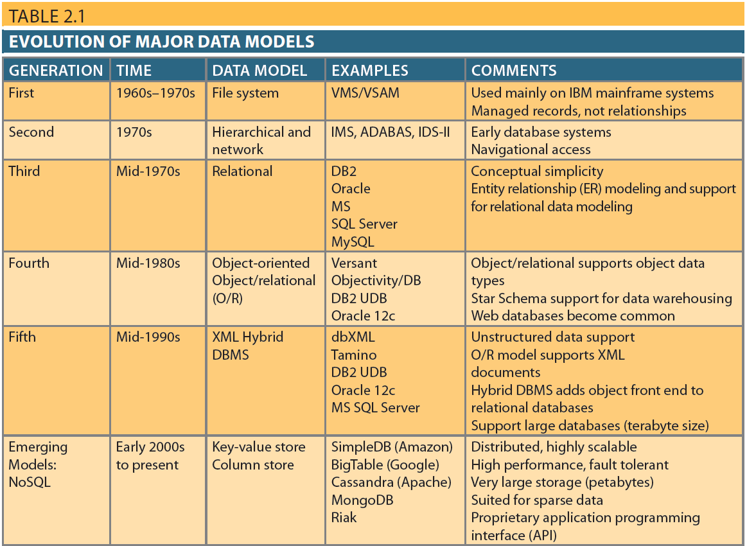
The Evolution of Data Models

Slide 13
The Hierarchical Model
The hierarchical model was developed in the 1960s to manage large amounts of data for manufacturing projects
Basic logical structure is represented by an upside-down “tree”
Hierarchical structure contains levels or segments
Segment analogous to a record type
Set of one-to-many relationships between segments
Ex: IBM’s IMS DBMS
Notes:
‹#›

Slide 14
The Network Model
The network model was created to represent complex data relationships more effectively than the hierarchical model
Improves database performance
Imposes a database standard
Resembles hierarchical model
However, record may have more than one parent
Ex: Computer Associates(now C.A.) IDS and IDMS
Notes:
‹#›

Slide 15
The Network Model (cont’d.)
Collection of records in 1:M relationships
Set composed of two record types:
Owner
Equivalent to the hierarchical model’s parent
Member
Equivalent to the hierarchical model’s child
Notes:
‹#›

Slide 16
The Network Model (cont’d.)
Concepts still used today:
Schema
Conceptual organization of entire database as viewed by the database administrator
Subschema
Database portion “seen” by the application programs
Notes:
‹#›

Slide 17
The Network Model (cont’d.)
Concepts still used today: (cont’d.)
Data management language (DML)
Defines the environment in which data can be managed
Data definition language (DDL)
Enables the administrator to define the schema components
Notes:
‹#›

Slide 18
The Network Model (cont’d.)
Disadvantages of the network model:
Cumbersome
Lack of ad hoc query capability placed burden on programmers to generate code for reports
Structural change in the database could produce havoc in all application programs
Notes:
‹#›

Slide 19
The Relational Model
Developed by E.F. Codd (IBM) in 1970
Table (relations)
Matrix consisting of row/column intersections
Each row in a relation is called a tuple
Relational models were considered impractical in 1970
Model was conceptually simple at expense of computer overhead
Ex: IBM’s DB2, Informix, Oracle, Sybase, Microsoft’s Access, FoxBase, Paradox, MySQL, Tandem, and Teradata
Notes:
‹#›

Slide 20
The Relational Model (cont’d.)
Relational data management system (RDBMS)
Performs same functions provided by hierarchical model
Hides complexity from the user
Relational diagram
Representation of entities, attributes, and relationships
Relational table stores collection of related entities
Notes:
‹#›

Slide 21
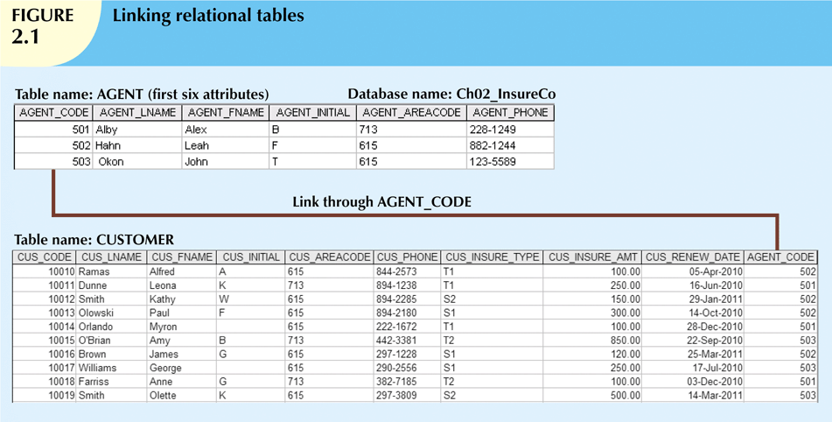
Notes:
‹#›

Slide 22
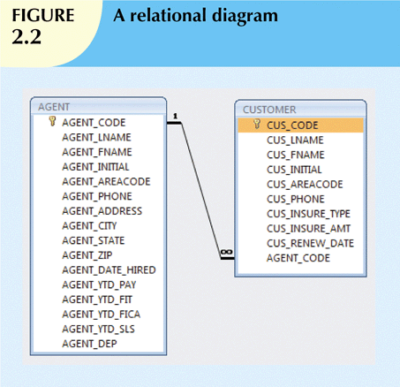
Notes:
‹#›

Slide 23
The Relational Model (cont’d.)
SQL-based relational database application involves three parts:
User interface
Allows end user to interact with the data
Set of tables stored in the database
Each table is independent from another
Rows in different tables are related based on common values in common attributes
SQL “engine”
Executes all queries
Notes:
‹#›

Slide 24
The Entity Relationship Model
Widely accepted standard for data modeling
Introduced by Chen in 1976
Graphical representation of entities and their relationships in a database structure
Entity relationship diagram (ERD)
Uses graphic representations to model database components
Entity is mapped to a relational table
Notes:
‹#›

Slide 25
The Entity Relationship Model (cont’d.)
Entity instance (or occurrence) is row in table
Entity set is collection of like entities
Connectivity labels types of relationships
Relationships are expressed using Chen notation
Relationships are represented by a diamond
Relationship name is written inside the diamond
Crow’s Foot notation used as design standard in this book
Notes:
‹#›

Slide 26
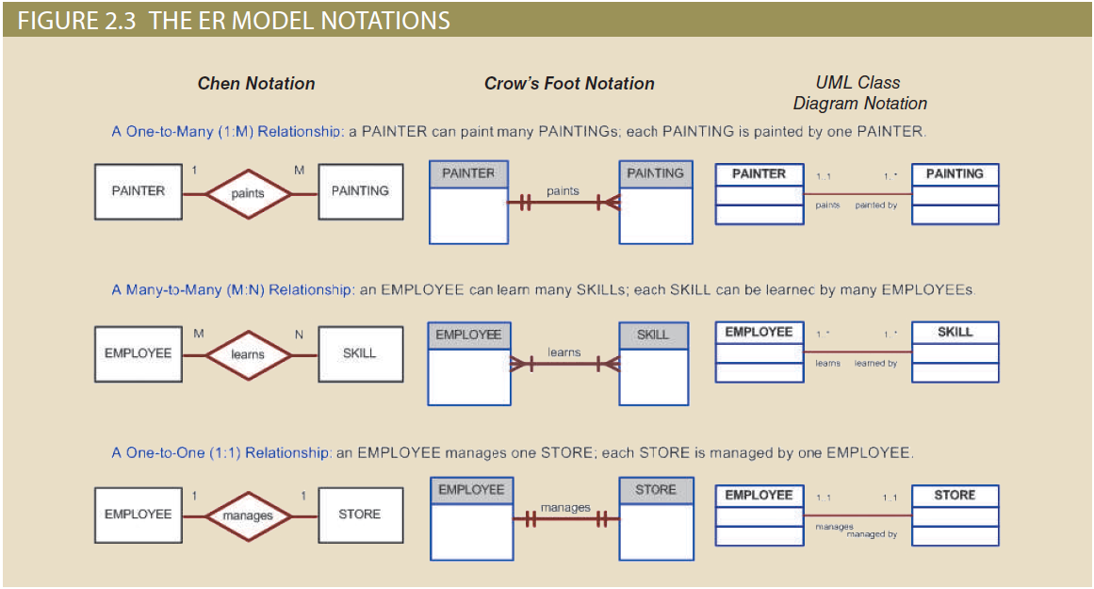
ER Model Notations
Notes:
‹#›

Slide 27
The Object-Oriented (OO) Model
Data and relationships are contained in a single structure known as an object
OODM (object-oriented data model) is the basis for OODBMS
Semantic data model
An object:
Contains operations
Are self-contained: a basic building-block for autonomous structures
Is an abstraction of a real-world entity
Ex: Objectstore and Versant
Notes:
‹#›

Slide 28
The Object-Oriented (OO) Model (cont’d.)
Attributes describe the properties of an object
Objects that share similar characteristics are grouped in classes
Classes are organized in a class hierarchy
Inheritance: object inherits methods and attributes of parent class
UML based on OO concepts that describe diagrams and symbols
Used to graphically model a system
Notes:
‹#›

Slide 29
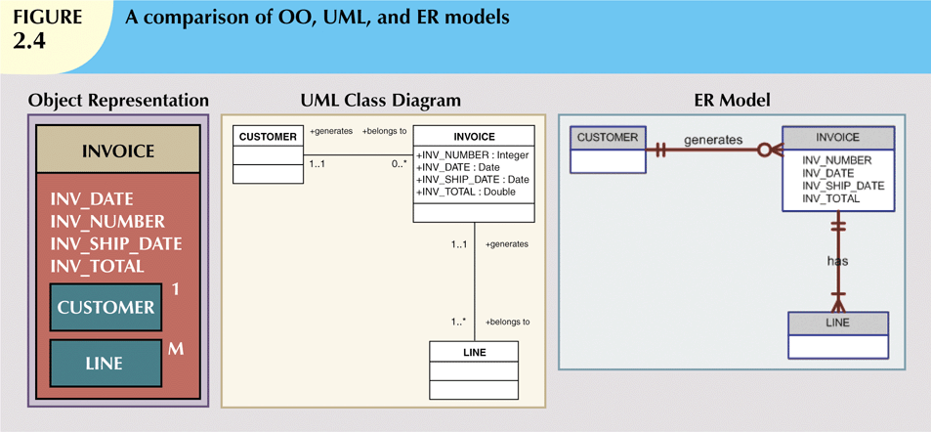
Notes:
‹#›

Slide 30
Newer Data Models: Object/Relational and XML
Extended relational data model (ERDM)
Semantic data model developed in response to increasing complexity of applications
Includes many of OO model’s best features
Often described as an object/relational database management system (O/RDBMS)
Primarily geared to business applications
OO DBMS is popular in niche markets such as computer-aided drawing/computer-aided manufacturing (CAD/ CAM), geographic information systems (GIS), telecommunications, and multimedia, which require support for more complex objects.
Ex: DBMS products from IBM, Informix, ObjectStore, Oracle, Versant, PostgreSQL, and others
Notes:
‹#›

Slide 31
Newer Data Models: Object/Relational and XML (cont’d.)
The Internet revolution created the potential to exchange critical business information
In this environment, Extensible Markup Language (XML) emerged as the de facto standard
Current databases support XML
XML: the standard protocol for data exchange among systems and Internet services

Slide 32
Emerging Data Models: Big Data and NoSQL
Big Data refers to movement to find new and better ways to manage large amounts of web and sensor-generated data and derive business insight from it, while simultaneously providing high performance and scalability at a reasonable cost.
Basic characteristics of Big Data databases: volume, velocity, and variety.
Volume refers to the amounts of data being stored.
Velocity refers not only to the speed with which data grows but also to the need to process this data quickly.
Variety refers to the fact that the data being collected comes in multiple different data formats.

Slide 33
Emerging Data Models: Big Data and NoSQL
Some of the most frequently used Big Data technologies are Hadoop, MapReduce, and NoSQL databases.
Hadoop is neither a database nor a data model. It is a distributed file storing and processing model. There is no Hadoop DBMS. NoSQL databases are databases, and the NoSQL model represents a different way of approaching the storage and processing of data in a nonrelational way.
NoSQL databases provide distributed, fault-tolerant databases for processing nonstructured data.

Slide 34
The Future of Data Models
Hybrid DBMSs
Retain advantages of relational model
Provide object-oriented view of the underlying data
SQL data services
Store data remotely without incurring expensive hardware, software, and personnel costs
Companies operate on a “pay-as-you-go” system

Slide 35
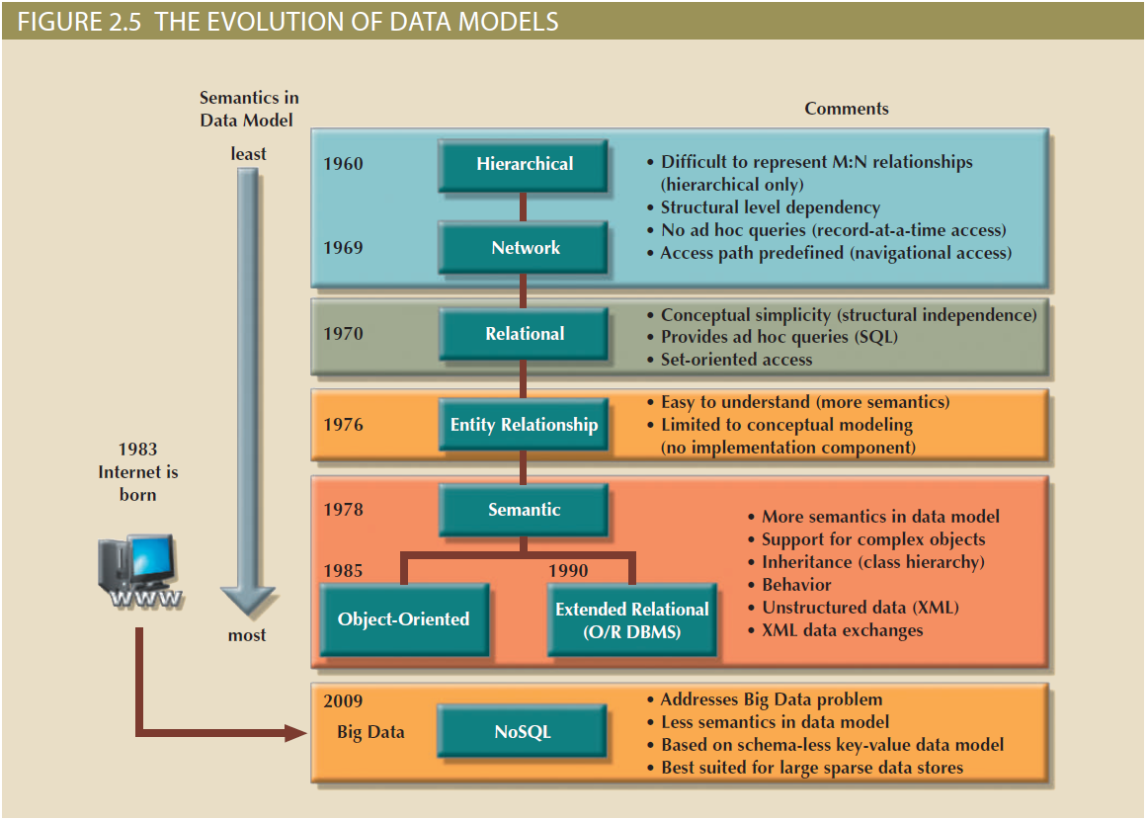
Notes:
‹#›

Slide 36
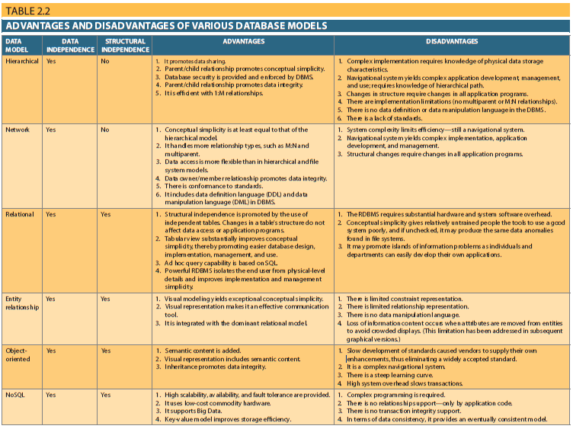

Slide 37
Data Models: A Summary
Common characteristics:
Conceptual simplicity with semantic completeness
Represent the real world as closely as possible
Real-world transformations must comply with consistency and integrity characteristics
Each new data model capitalized on the shortcomings of previous models
Some models better suited for some tasks
Notes:
‹#›

Slide 38
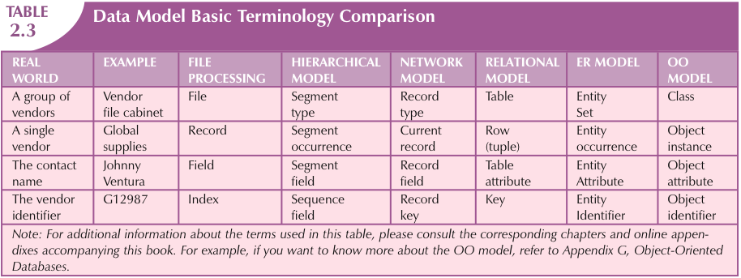

Slide 39
Degrees of Data Abstraction
Database designer starts with abstracted view, then adds details
Data abstraction is the idea that a database design begins with a high-level view and as it approaches implementation level, the level of detail increases. The benefit to using levels of abstraction is the ability to work with and integrate multiple views into a cohesive set.
ANSI Standards Planning and Requirements Committee (SPARC)
Defined a framework for data modeling based on degrees of data abstraction (1970s):
External
Conceptual
Internal(physical in some resources)
Notes:
‹#›

Slide 40
The External Model(Schema)
End users’ view of the data environment
ER diagrams represent external views
External schema: specific representation of an external view
Entities
Relationships
Processes
Constraints
Notes:
‹#›

Slide 41
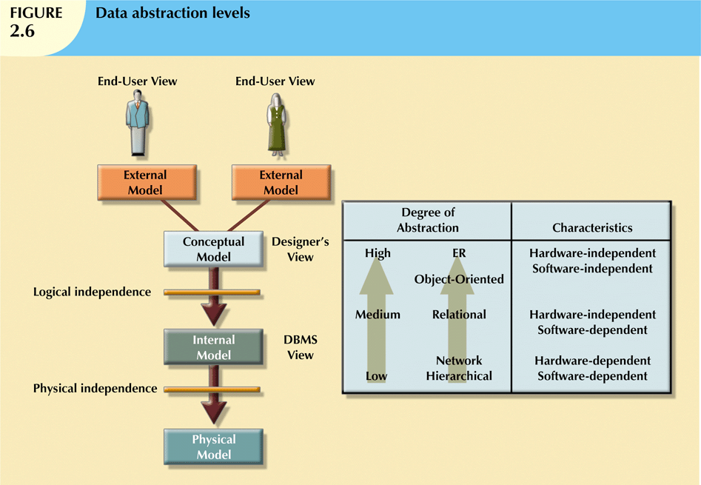

Slide 42
The External Model (cont’d.)
Easy to identify specific data required to support each business unit’s operations
Facilitates designer’s job by providing feedback about the model’s adequacy
Ensures security constraints in database design
Simplifies application program development
Notes:
‹#›

Slide 43
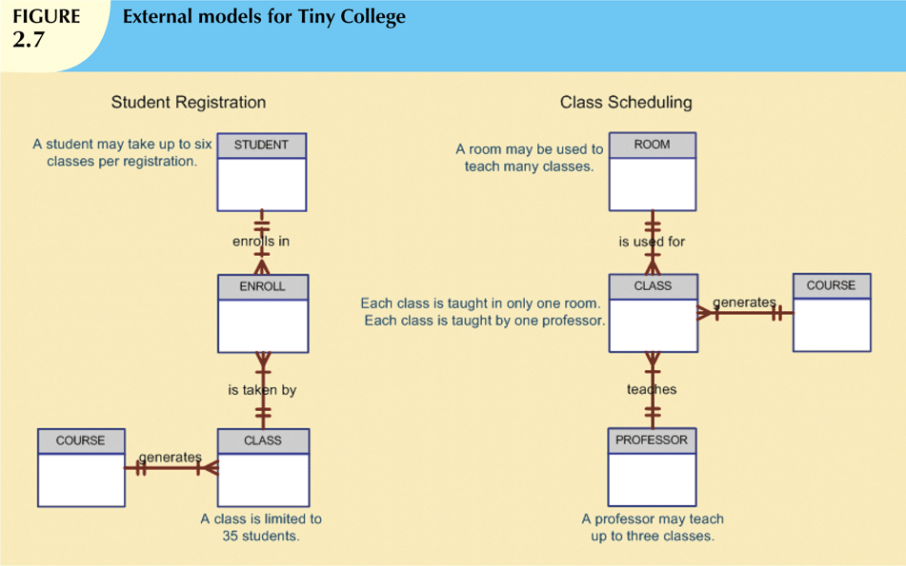

Slide 44
The Conceptual Model
Represents global view of the entire database
All external views integrated into single global view: conceptual schema
ER model most widely used
ERD graphically represents the conceptual schema
Notes:
‹#›

Slide 45
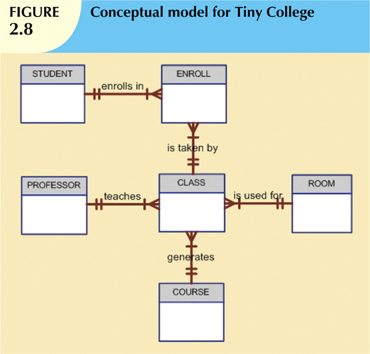
Notes:
‹#›

Slide 46
The Conceptual Model*
Example schemas in a conceptual model:
Students(sid: string, name: string, login: string, age: integer, gpa: real)
Faculty(fid: string, fname: string, sal: real)
Courses(cid: string, cname: string, credits: integer)
Rooms(rno: integer, address: string, capacity: integer)
Enrolled(sid: string, cid: string, grade: string)
Teaches(fid: string, cid: string)
Meets In(cid: string, rno: integer, time: string)
* Database Systems(Ramakrishnan) 3rd Ed.

Slide 47
The Conceptual Model (cont’d.)
Provides a relatively easily understood macro level view of data environment
Independent of both software and hardware
Does not depend on the DBMS software used to implement the model
Does not depend on the hardware used in the implementation of the model
Changes in hardware or software do not affect database design at the conceptual level
Notes:
‹#›

Slide 48
The Internal Model
Representation of the database as “seen” by the DBMS
Maps the conceptual model to the DBMS
Internal schema depicts a specific representation of an internal model
Depends on specific database software
Change in DBMS software requires internal model be changed
Logical independence: change internal model without affecting conceptual model
Notes:
‹#›

Slide 49
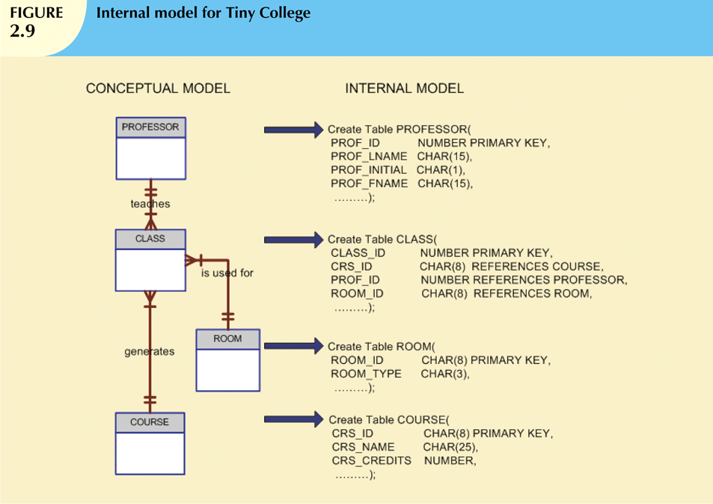
Notes:
‹#›

Slide 50
The Physical Model
Operates at lowest level of abstraction
Describes the way data are saved on storage media such as disks or tapes
Requires the definition of physical storage and data access methods
Relational model aimed at logical level
Does not require physical-level details
Physical independence: changes in physical model do not affect internal model
Most sources include this model into Internal Model(so there is no extra Physical Model)
Notes:
‹#›

Slide 51
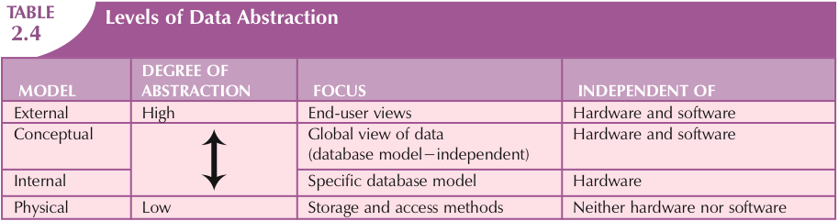
Notes:
‹#›

Slide 52
Summary
A data model is an abstraction of a complex real-world data environment
Basic data modeling components:
Entities
Attributes
Relationships
Constraints
Business rules identify and define basic modeling components
Notes:
‹#›

Slide 53
Summary (cont’d.)
Hierarchical model
Set of one-to-many (1:M) relationships between a parent and its children segments
Network data model
Uses sets to represent 1:M relationships between record types
Relational model
Current database implementation standard
ER model is a tool for data modeling
Complements relational model
Notes:
‹#›

Slide 54
Summary (cont’d.)
Object-oriented data model: object is basic modeling structure
Relational model adopted object-oriented extensions: extended relational data model (ERDM)
OO data models depicted using UML
Data-modeling requirements are a function of different data views and abstraction levels
Three abstraction levels: external, conceptual, internal
Notes:
‹#›

